Slide 1
Translate All The Things!
An Introduction to LibreTranslate
Piero Toffanin (pierotofy) - piero.dev

Slide 2

- FOSS (AGPLv3) for natural language translation
- Runs on your computer
- Lots of clients / integrations
- https://github.com/LibreTranslate/LibreTranslate

Slide 3
Why LibreTranslate?
- A simple, open REST API
- Pre-trained, openly licensed language models
- Runs on commodity hardware
- Easy to setup

Slide 4
Getting Started
- Python/PIP
$ pip install libretranslate
$ libretranslate
- Docker. Clone from GitHub, then:
$ ./run.sh

Slide 5
Getting Started
- http://127.0.0.1:5000 - http://127.0.0.1:5000/docs
$ curl -X POST http://127.0.0.1:5000/translate -d q="Bonjour FOSDEM!" -d source=auto -d target=nl
{"detectedLanguage":{"confidence":93.0,"language":"fr"},"translatedText":"Hallo, FOSDEM!"}

Slide 6
Getting Real
curl -X POST http://127.0.0.1:5000/translate -d source=auto -d target=en -d "q=<p>Le <b>Chat domestique</b> (<span class=\"lang-la\" lang=\"la\"><i><b>Felis silvestris catus</b></i></span>) est la <a href=\"/wiki/Sous-esp%C3%A8ce\" title=\"Sous-espèce\">sous-espèce</a> issue de la <a href=\"/wiki/Domestication\" title=\"Domestication\">domestication</a> du <a href=\"/wiki/Felis_silvestris\" title=\"Felis silvestris\">Chat sauvage</a> (<span class=\"lang-la\" lang=\"la\"><i>Felis silvestris</i></span>), <a href=\"/wiki/Mammif%C3%A8re\" title=\"Mammifère\">mammifère</a> <a href=\"/wiki/Carnivora\" title=\"Carnivora\">carnivore</a> de la <a href=\"/wiki/Famille_(biologie)\" title=\"Famille (biologie)\">famille</a> des <a href=\"/wiki/Felidae\" title=\"Felidae\">Félidés</a>.</p>" -d format=html

Slide 7
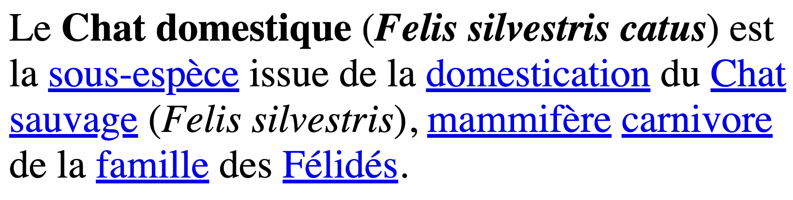
Getting Real

Slide 8
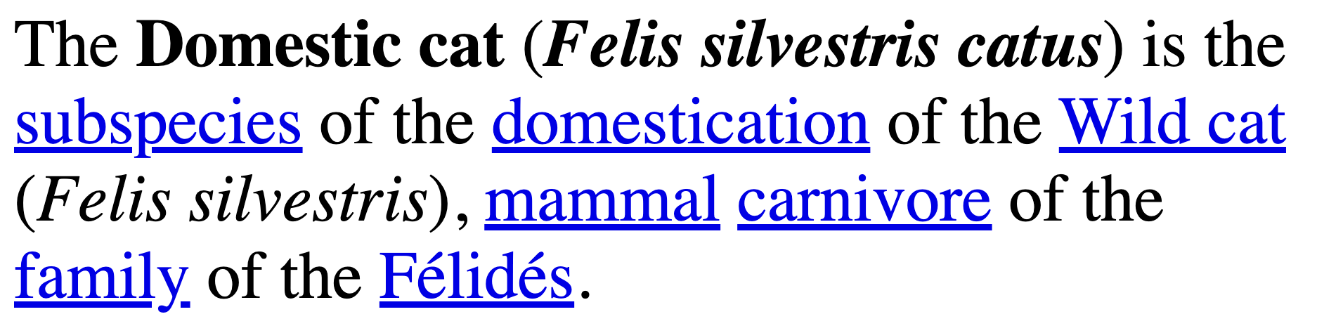
Getting Real
Kind of right. Should be "Felidae"

Slide 9
Features
- Text translation
- Markup (HTML) translation
- File Translation
- Language detection
- Rate limits, API key management
- Localized UI
- Monitoring (via Prometheus + Grafana)

Slide 10
What's Inside
argos-translate
ctranslate2 sentencepiece stanza
models
argos-translate-files
argospm-index
flask
gunicorn
cld2
swagger
Notes:
ctranslate2 --> library for inference using transformer models by OpenNMT
sentencepiece --> Google library for tokenization
stanza --> library to perform linguistic analysis by Stanford NLP Group

Slide 11
Language Models
- 58 models (30 languages)
- https://www.argosopentech.com/argospm/index
- Automatic pivot via English
- Language missing?
- https://github.com/argosopentech/argos-train

Slide 12
Language Models
- Models packed as .argosmodel files (.zip)
- metadata.json ==> Package meta
- model/ ==> CTranslate2 model
- sentencepiece.model ==> SentencePiece model
- stanza ==> Stanza model

Slide 13
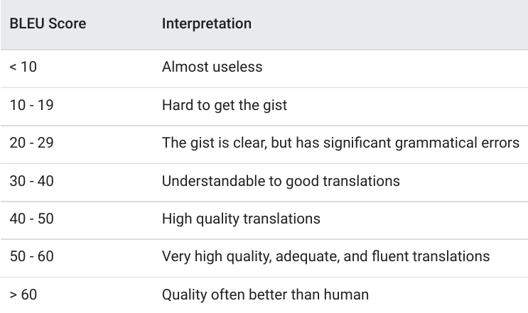
Accuracy
BiLingual Evaluation Understudy
Measures the similarity of the machine-translated text to a set of high quality reference translations
Source: https://cloud.google.com/translate/automl/docs/evaluate

Slide 14
Accuracy
- 83% of models tested above 40%
- Better training data => Better models
- Occasional rare quirks (salad)

Slide 15
Integrations
- Client libs: 11+ programming languages
- Software: Mastodon, Weblate, Discourse (plugin), LibreOffice (extension), Kodi (addon), Firefox (addon)
- Client apps: Android, iOS, Desktop

Slide 16
API Comparison
LibreTranslate | Free
Yandex | $6 / 1M chars
Bing | $8.22 / 1M chars
Google | $20 / 1M chars
DeepL | $25 / 1M chars

Slide 17
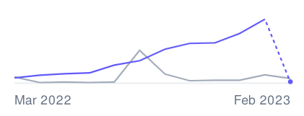
Funding
- Self-funded (+364% growth Y/Y)
- Cloud-hosted instance at libretranslate.com
- Support the project
- Get an API Key

Slide 18
Get Involved
- 70+ contributors
- Help with code
- Help translate https://hosted.weblate.org/projects/libretranslate/app/
- Help train models: https://github.com/argosopentech/argos-train
- Report bugs
- Just say hi: https://community.libretranslate.com

Slide 19
Questions?
piero.dev

